Slide 1
Azure Core Enablement
aka.ms/RocAzure
February 2019
Trey Talbott Mike McKechney Anthony Martin
trey.talbott@microsoft.com michael.mckechney@microsoft.com anthma@microsoft.com
@treytalbott @mmckechney @SQLMartini

Slide 2
Agenda
Opening Remarks
RocAzure Charter
Introductions
First timers.
Review Calendar
What’s new?
Azure Updates and Roadmap
Keynote
Wrap up and Network

Slide 3
Rochester User Group Charter
Salesy
Stuff
Cloud computing is a journey.
This User Group exists to:
Serve a community of Azure enthusiasts
Demystify cloud computing concepts
Help accelerate your cloud journey
Stay current on Azure capabilities
Help each other with the journey
Share real world experiences and lessons learned

Slide 4
Introduction of first timers
Please share your:
Name and background
Cloud experience, if any
Azure, AWS, Google, etc…
What are your expectations being here
i.e., how can this group help you?
Fun fact

Slide 5
Upcoming Events
User Groups
March – Community Case Study - LinkedIn
April - Intro to Machine Learning and the Azure ML Platform
May – Community Case Study – Kodak Alaris
Other notable events
Microsoft Connect () online https://aka.ms/Connect2018
Product team roadshows – Registration links on meetup site
Feb 13 – Serverless Computing
Feb 21 – Enterprise Data Warehouse
March 19 – Tech Summit Series – https://aka.ms/RocTechSummit Woodcliff Hotel & Spa

Slide 6
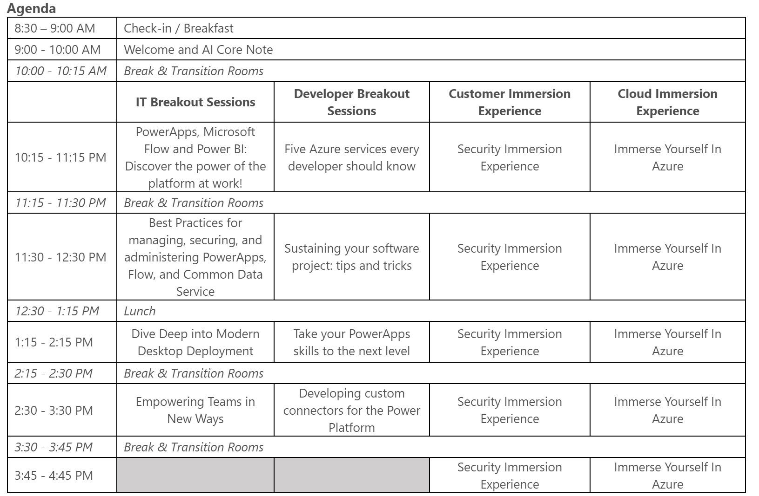
Upcoming Events March 19th – Tech Summit

Slide 7
Azure Training, Labs and Certifications
microsoft.com/learn
Notable changes:
Developer certification simplified to a single exam: AZ-203
New AZ-900: Microsoft Azure Fundamentals

Slide 8
Staying Current
aka.ms/LastWeek
Now GA…
News and Updates
Technical Content
Azure shows
Events
Customers, partners and industries

Slide 9
Notable updates
Query Store for Azure SQL Data Warehouse now GA
GA of Lsv2 series VMs (ideal for high throughput and IOPS)
Global VNet peering in China cloud
Microsoft acquires open source Citrus SQL
Regulatory compliance dashboard in Azure Security Center
Amazon RDS migration services now GA
Azure Monitor logs for Grafana in public preview
HDInsight now supported in Azure CLI in public preview
Azure portal updates – ACI functionality, links to make the most out of Azure
Azure obtains Korea-Information Security Management System certification (K-ISMS)
SSD Azure Data Box Disk now GA
Azure Migrate now GA in Gov Cloud
Python 2.7 for App Service on Linux now public preview

Slide 10
Azure Core Enablement

Slide 11



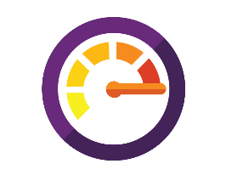

What organizations ultimately want…
Secure, predictable and flexible service delivery and operations capability (end to end traceability)
Control
Faster business innovation through adoption of cloud services
Innovation
Business agility and reduced time-to-market through efficient DevOps teams
Speed/Agility
Costs
Efficient use of public cloud scale

Slide 12
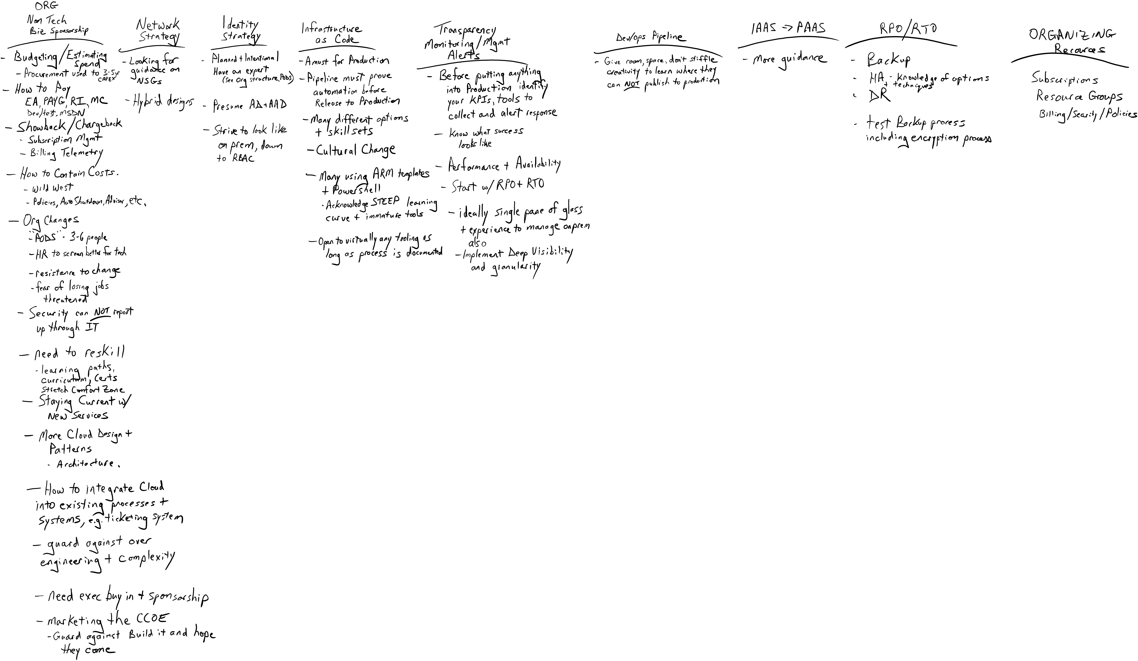
First draft of summit notes (11/2018)… Number of non-technical, organizational comments was telling

Slide 13





Core Enablement Capabilities for Success
Business
Opportunities for moving to the cloud
Security
Security Hygiene
Network strategy
Resiliency
Application architecture
Operations
Organizing resources
Automation
Automation capabilities
People strategy
Governance, Risk and Compliance
Cloud design patterns
Azure services
Cost management
Monitoring and management strategy
Automation opportunities
Identity and access control

Slide 14
Core Enablement Capabilities for Success
Business
Opportunities for moving to the cloud
Security
Security Hygiene
Network strategy
Resiliency
Application architecture
Operations
Organizing resources
Automation
Automation capabilities
People strategy
Governance, Risk and Compliance
Cloud design patterns
Azure services
Cost management
Monitoring and management strategy
Automation opportunities
Identity and access control

Slide 15
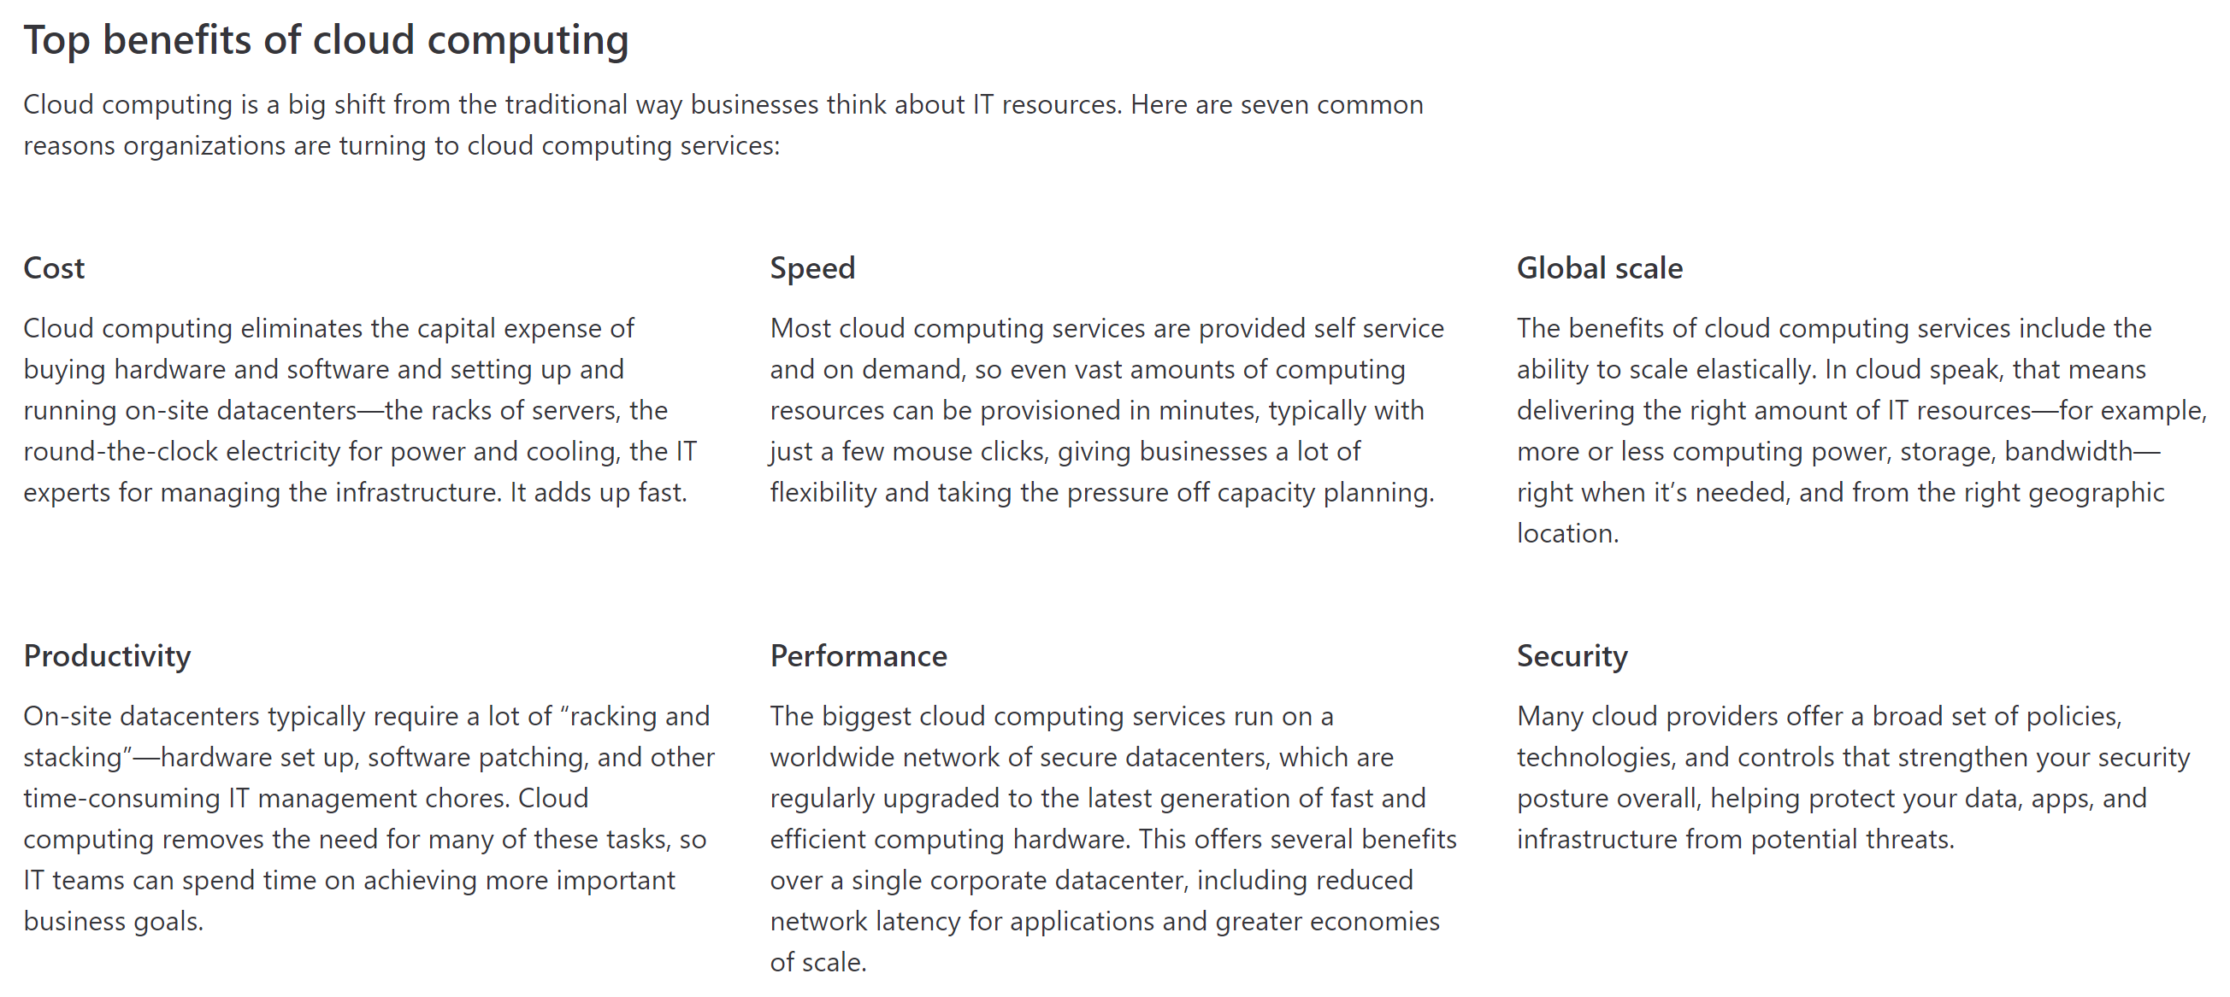
Opportunities for moving to the cloud – ‘WHY Cloud?’

Slide 16
Why Cloud Center of Excellence?
Shift the value of the IT department from build, own and run, to enable others to do autonomously
Traditional Enterprise
Modern Enterprise
Business Unit
Service Consumer
Developers & functional application owners
BizDevOps teams
IT Department
IT as partner
CCoE (Setup BizDevOps /
Cloud Foundation)
IT as intermediaries
IT as broker
(remaining IT functions like procurement, billing, compliance)
Hosting/Cloud Provider

Slide 17
CCoE formation

Slide 18
Governance, Risk and Compliance
Governance is the combination of processes established and executed by leadership that are used to achieve goals
Risk management is predicting, understanding, and managing reisks that could otherwise hinder or prevent the organization from achieving its objectives
Compliance refers to adhering to policies and procedures as well as laws and regulations
GRC is NOT normally a “net-new” function for the cloud.
GRC professionals should fully understand the implications that the cloud has for their areas and extend existing practices

Slide 19

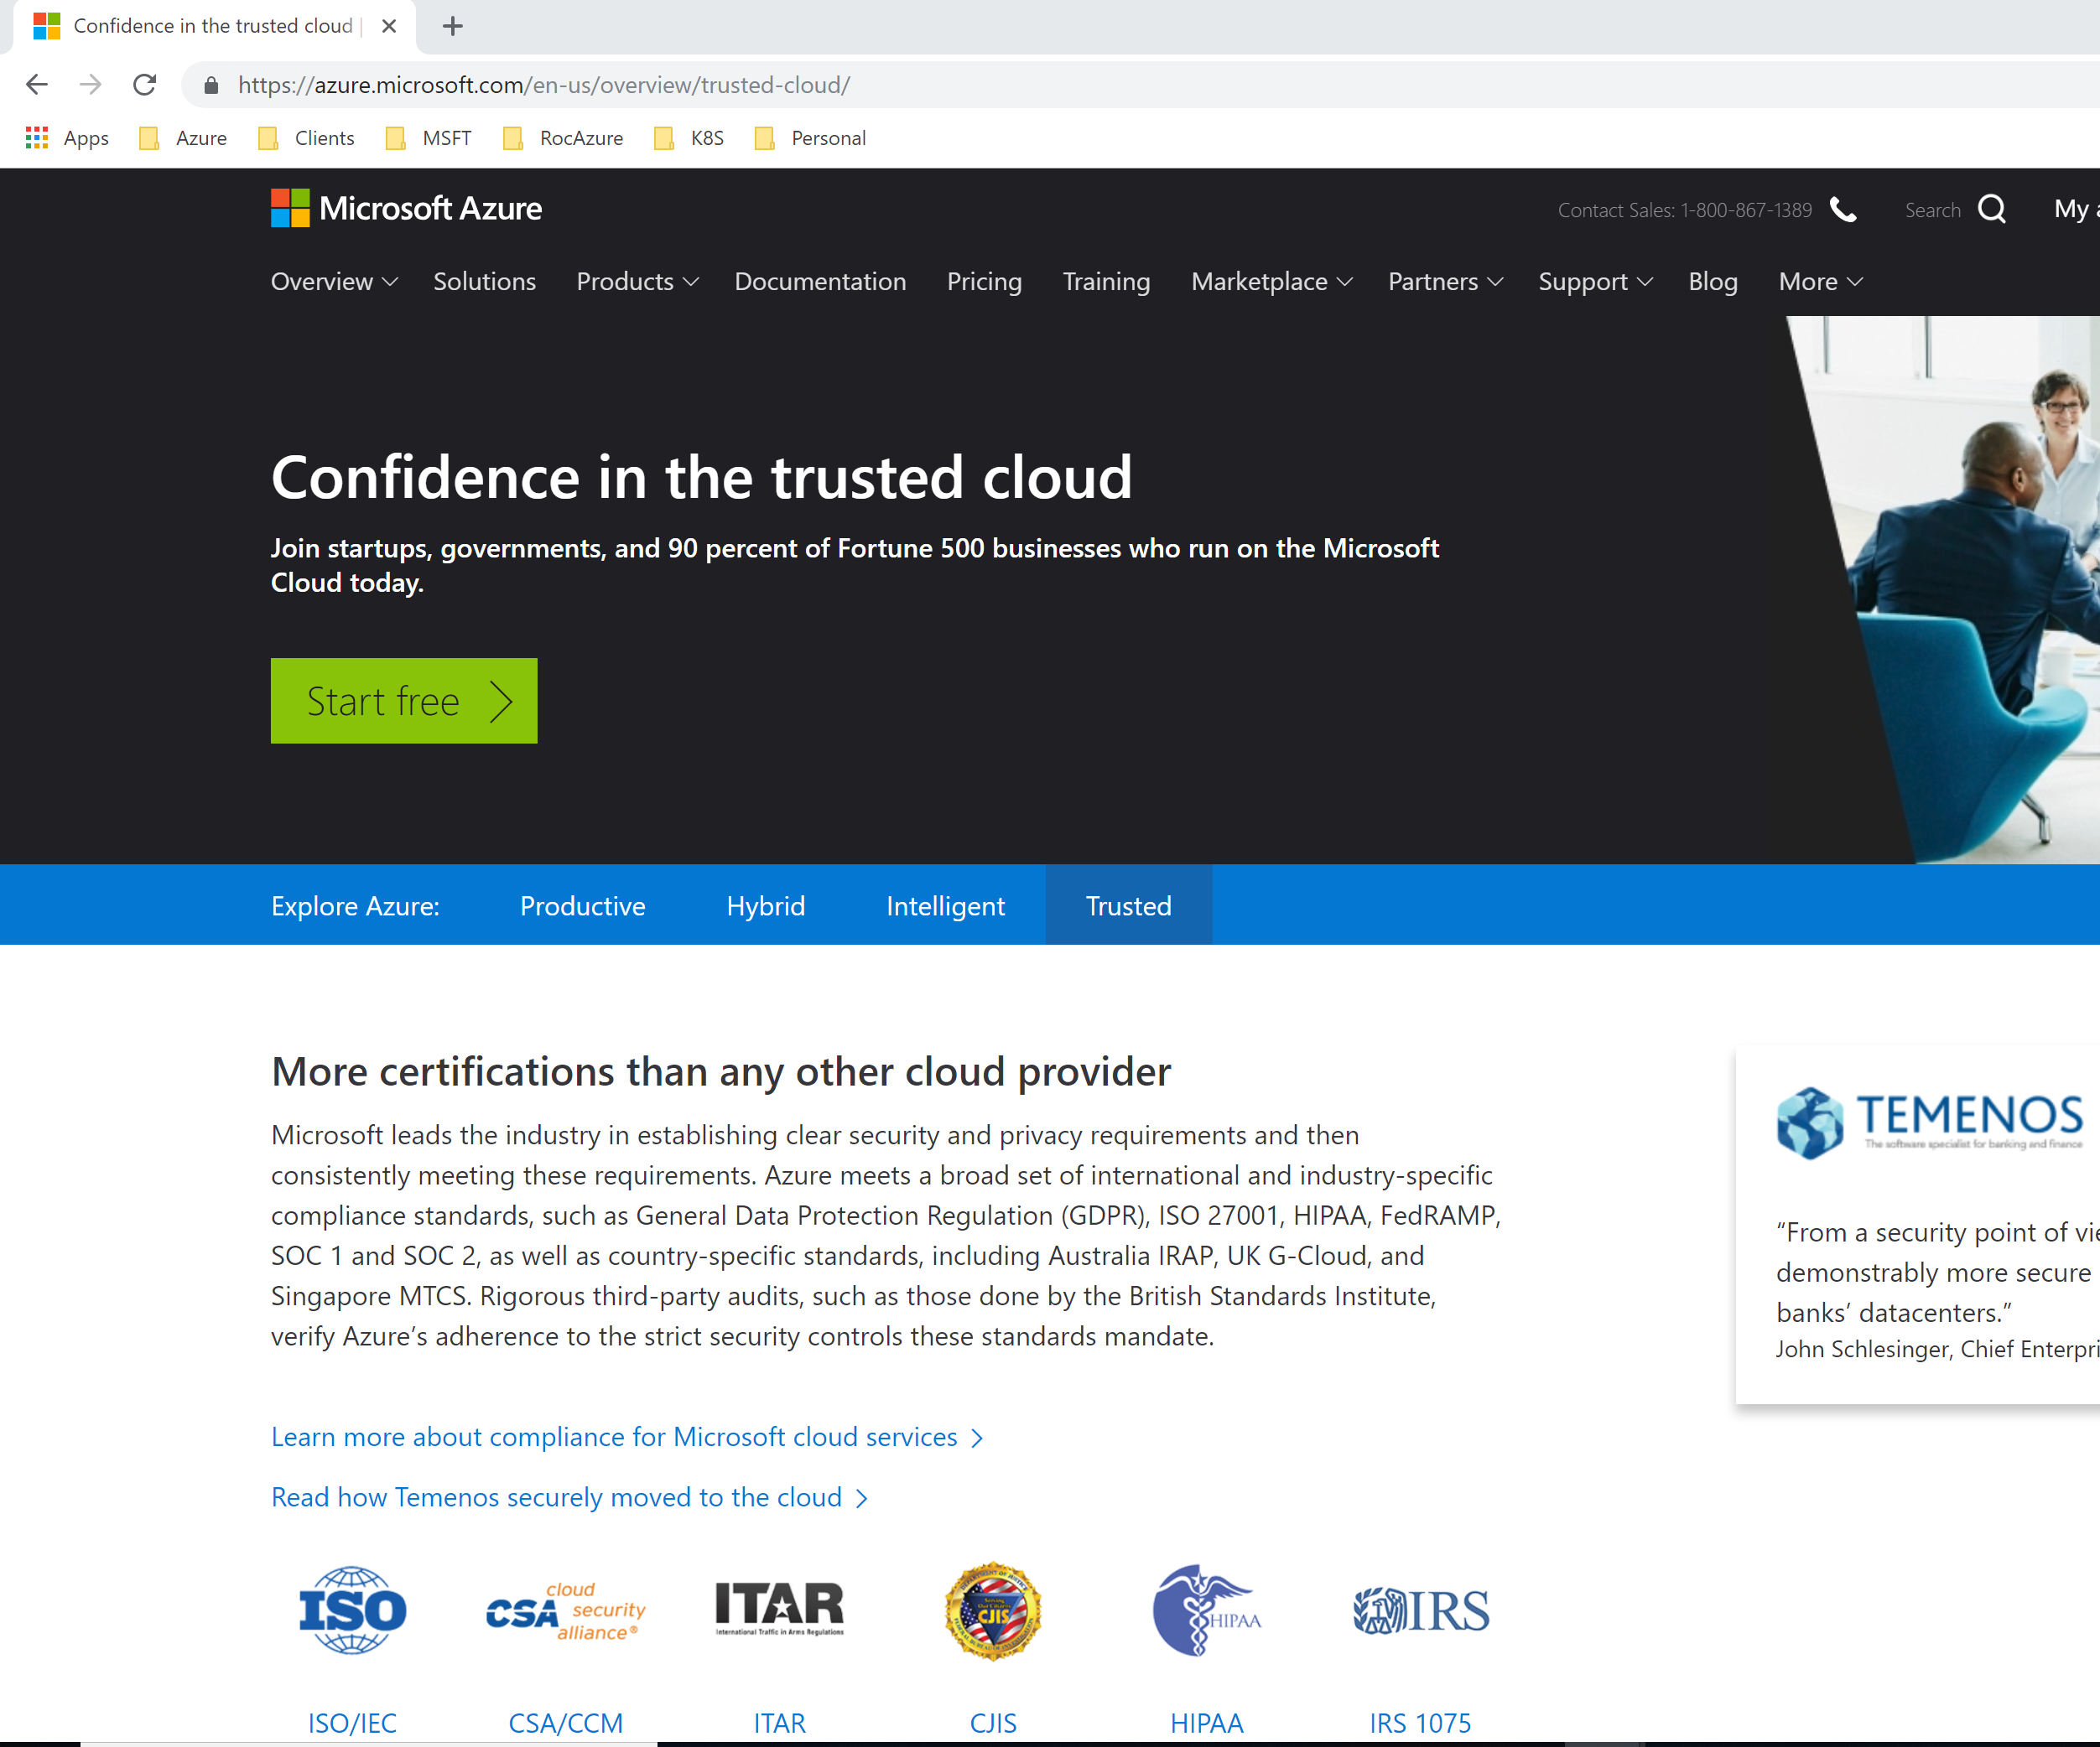
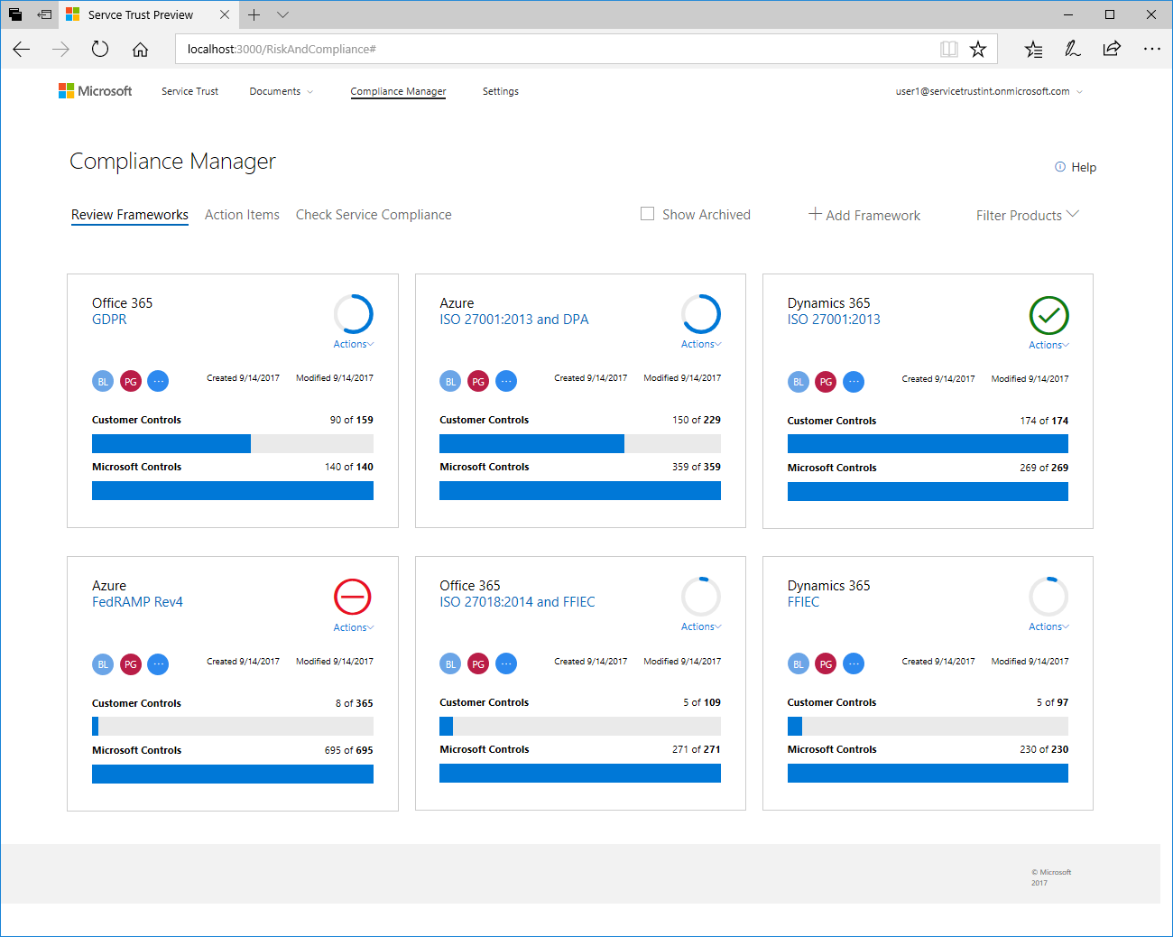
Azure Trust Center One stop for Azure trust
More certifications than any other cloud provider
Strengthen your security posture with Azure
Own and control your data

Slide 20
Compliance manager Manage your compliance from one place
Real-time risk assessment An intelligent score shows your compliance posture against evolving regulations
Actionable insights Recommended actions to improve your data protection capabilities
Simplified compliance Streamlined workflow and audit-ready reports

Slide 21
In summary - Business Capabilities for Success
Business
Opportunities for moving to the cloud
People strategy
Governance, Risk and Compliance
May need to coach management on the “Why” cloud to gain executive sponsorship
Strongly recommend a ‘Cloud Center of Excellence’
Familiarize yourself with Azure Trust Center and Compliance Manager capabilities

Slide 22
Core Enablement Capabilities for Success
Business
Opportunities for moving to the cloud
Security
Security Hygiene
Network strategy
Resiliency
Application architecture
Operations
Organizing resources
Automation
Automation capabilities
People strategy
Governance, Risk and Compliance
Cloud design patterns
Azure services
Cost management
Monitoring and management strategy
Automation opportunities
Identity and access control

Slide 23
Responsibility Zones
Always retained by customer
Varies by Service Type
Transfers to Cloud Provider

Slide 24

Azure security services
Identity & access management
Data protection
Network security
Threat protection
Security management
Azure Active Directory
Encryption
(Disks, Storage, SQL)
VNET, VPN, NSG
Azure Security Center¹
Multi-Factor
Authentication
Azure Key Vault
Application Gateway
(WAF)
Microsoft Antivirus
for Azure
Azure Log Analytics
Role Based Access
Confidential
computing
DDoS Protection
Standard
ExpressRoute
+ Partner Solutions
1- Azure Security Center includes threat protection across identity, compute, data & network

Slide 25











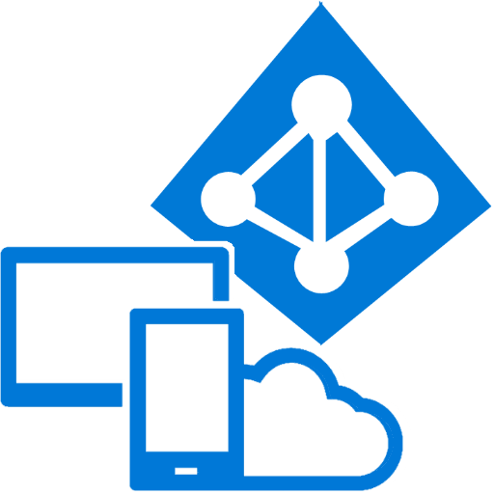

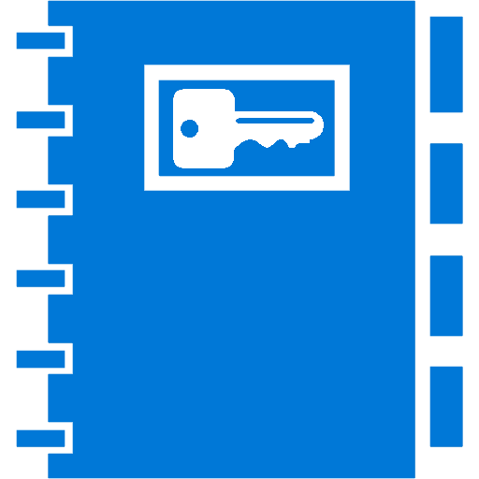
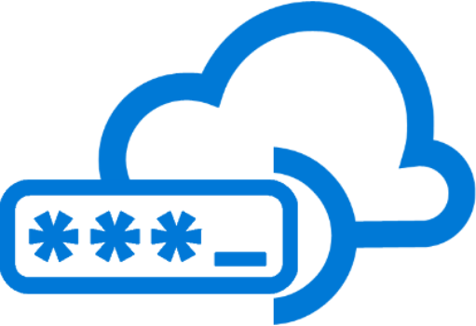




Azure Active Directory
— Identity and access management for employees, partners, and customers —
B2B collaboration
Provisioning-Deprovisioning
Addition of custom cloud apps
Access Panel/MyApps
Dynamic Groups
Identity Protection
Self-Service capabilities
Connect Health
Remote Access to on-premises apps
Azure AD B2C
Group-Based Licensing
Privileged Identity Management
Azure AD Connect
Conditional Access
Microsoft Authenticator - Password-less Access
Azure AD Join
MDM-auto enrollment /
Enterprise State Roaming
Security Reporting
SSO to SaaS
Multi-Factor Authentication
Azure AD DS
Office 365 App Launcher
HR App Integration
Access Reviews
Notes:
25
[keypoint]

Slide 26
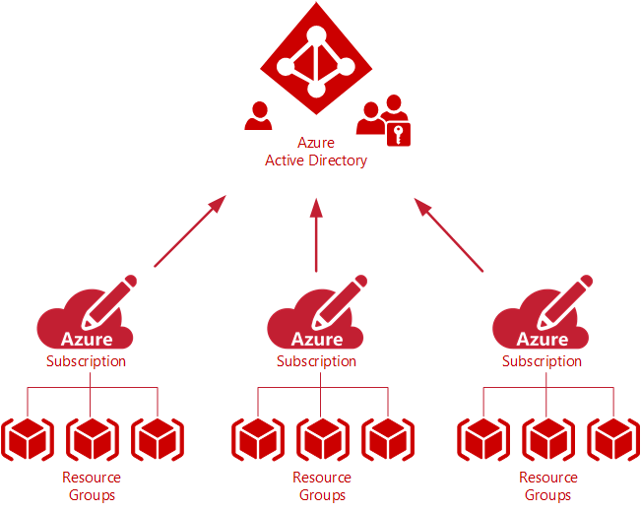
Role-based access controls
Azure RBAC has three basic roles that apply to all resource types:+
Owner has full access to all resources including the right to delegate access to others.
Contributor can create and manage all types of Azure resources but can't grant access to others.
Reader can view existing Azure resources.
Access Inheritance

Slide 27

Role Based Access Control
Owner
Contributor
Reader
 | Resource | Resource Group | Subscription
Blast Zone

Slide 28
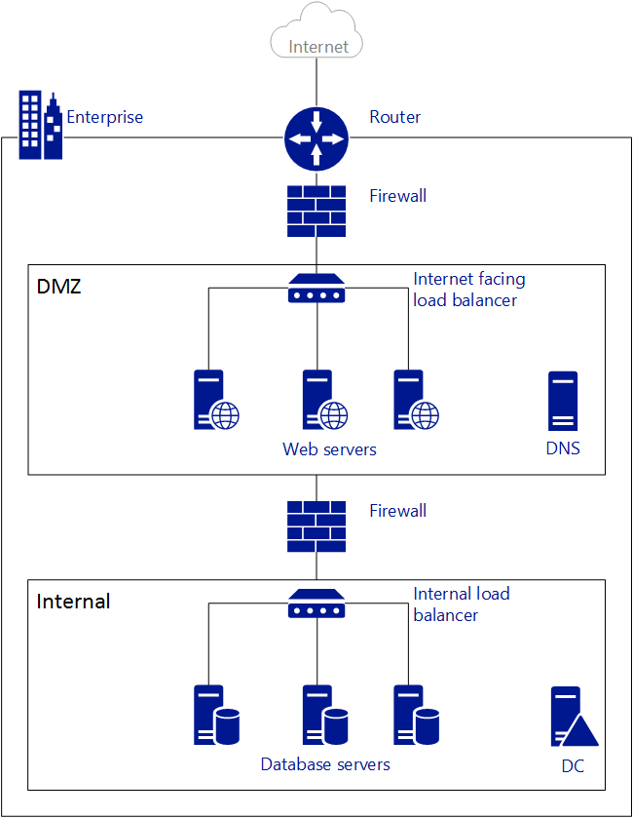
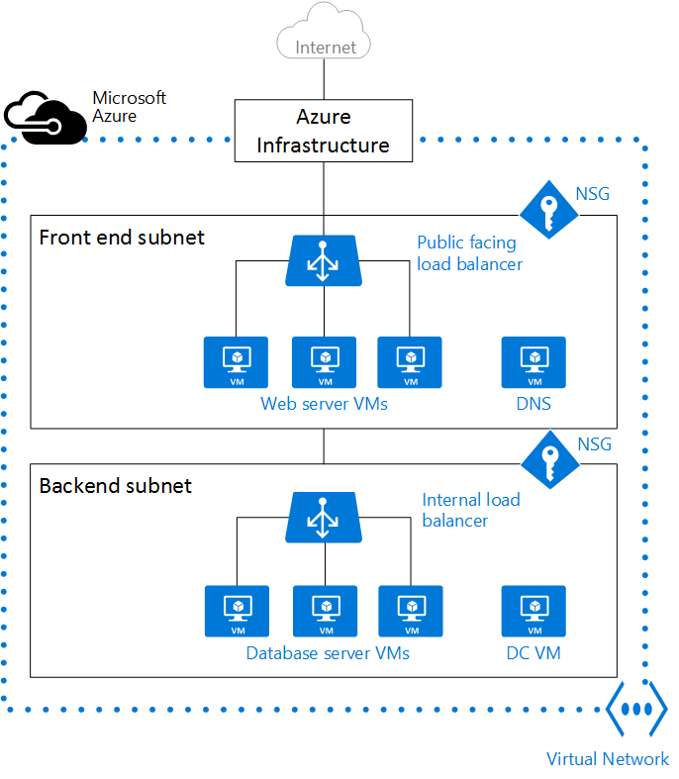
Azure Virtual Network Overview
Application
Gateway
Simplified On-Prem Network
As deployed in Azure

Slide 29
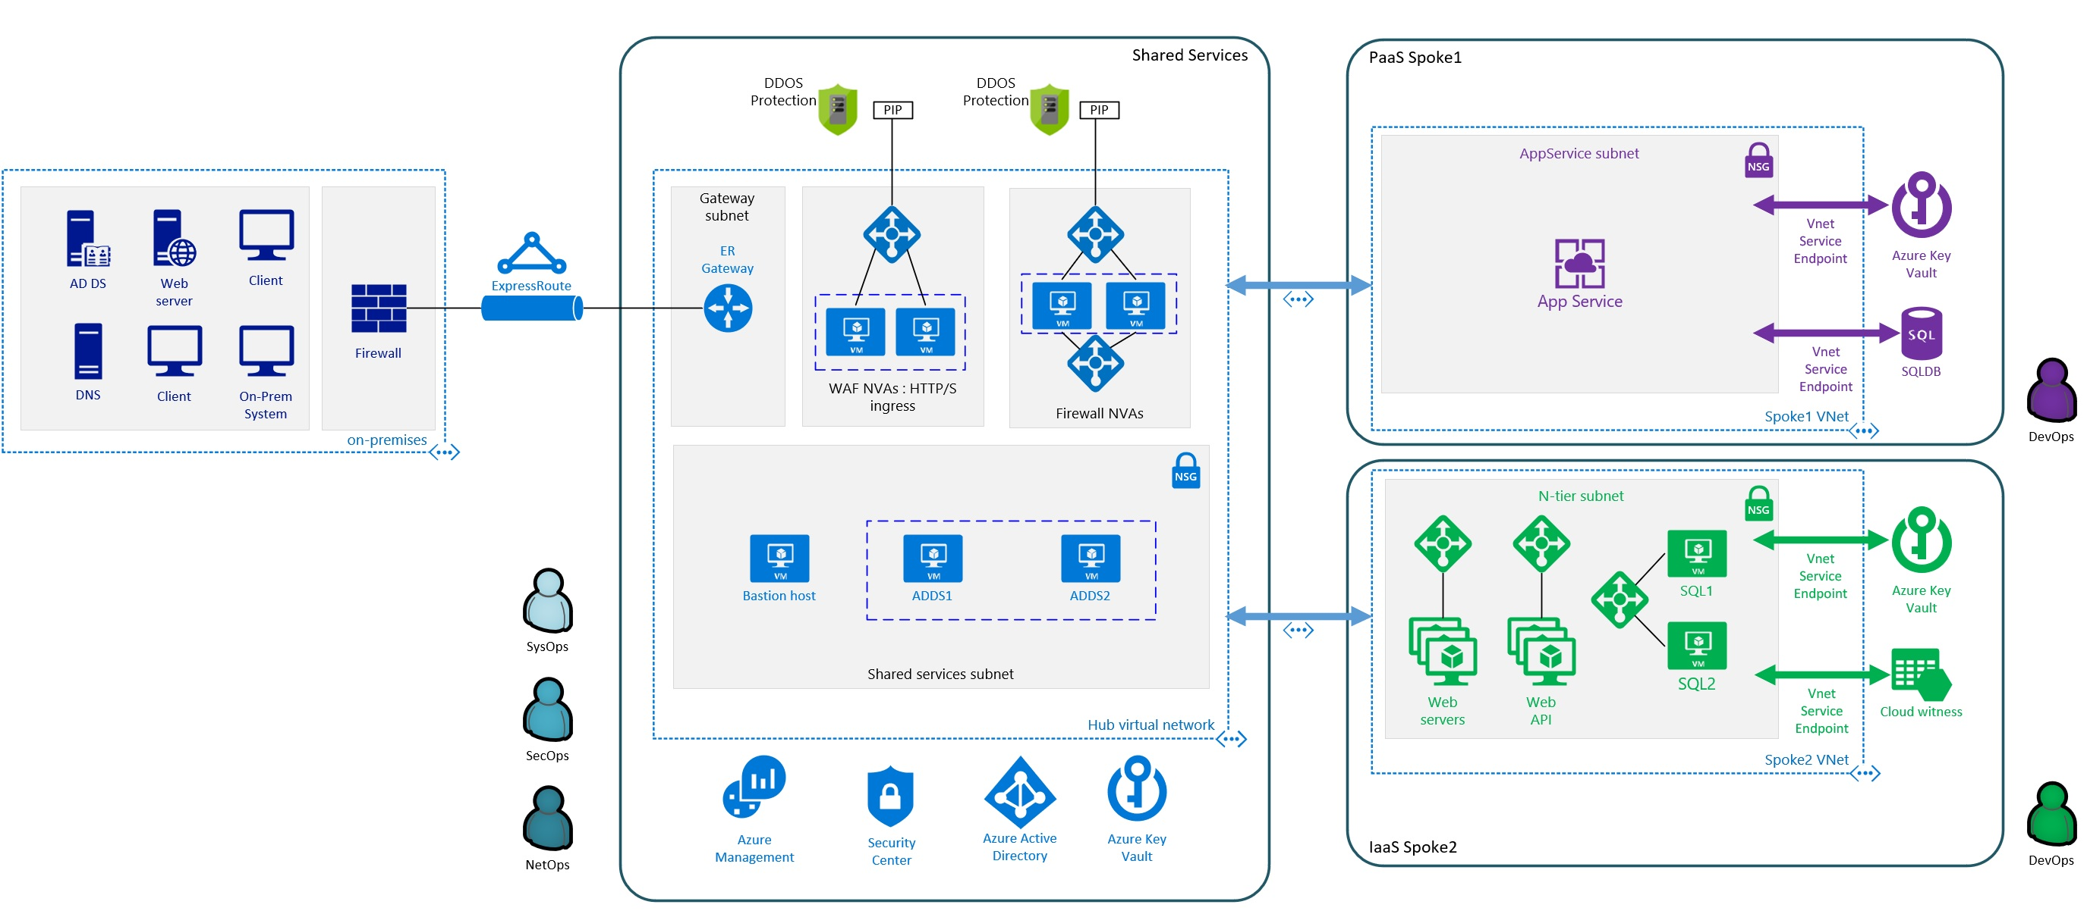





Hub & spoke architecture—native security services
Shared Services
PaaS Spoke1
DDOS Protection
DDOS Protection
PIP
PIP
AppService subnet
NSG
Gateway subnet
WAF: HTTP/s ingress
Egress
Ingress (non-http/s) Spoke-Spoke
Spoke-On-Prem
Azure Key Vault
AD DS
Web server
Client
ExpressRoute
NSG
App Service
Firewall
ER Gateway
Application Gateway
Azure firewall
SQLDB
Spoke1 VNet
DNS
Client
On-prem system
DevOps
On-premises
Iaas Spoke2
Shared services subnet
N-tier subnet
Native security services DDoS protection for Public IPs
App GW WAF—Web Application Protection Azure Firewall—Full VNET egress and ingress (non-http/s) protection
NSG—Internal VNET segmentation
Service endpoints—Secure access to public PaaS resources
NSG
NSG
SysOps
Bastion host
ADDS1
ADDS2
SQL1
Vnet Service Endpoint
Azure Key Vault
Hub virtual network
Web servers
Web API
SQL2
Vnet Service Endpoint
Cloud witness
SecOps
Spoke2 VNet
NetOps
Azure Management
Security Center
Azure Active Directory
Azure Key Vault
DevOps

Slide 30
In Summary - Security Capabilities for Success
Security
Security Hygiene
Identity and access control
Network strategy
Strive for vigilant Security Hygiene
Have a strong Identity and Access mgmt strategy
Have a strong networking security strategy
Utilize Azure Advisor and Azure Security Center
Leverage CIS Benchmarks

Slide 31
Core Enablement Capabilities for Success
Business
Opportunities for moving to the cloud
Security
Security Hygiene
Network strategy
Resiliency
Application architecture
Operations
Organizing resources
Automation
Automation capabilities
People strategy
Governance, Risk and Compliance
Cloud design patterns
Azure services
Cost management
Monitoring and management strategy
Automation opportunities
Identity and access control

Slide 32
Resiliency Considerations
Understand your requirements
Virtually every Azure service has a SLA
Legacy (i.e., client/server, three tier) –vs- Cloud Native Applications
HA –vs- DR
RPO –vs- RTO

Slide 33
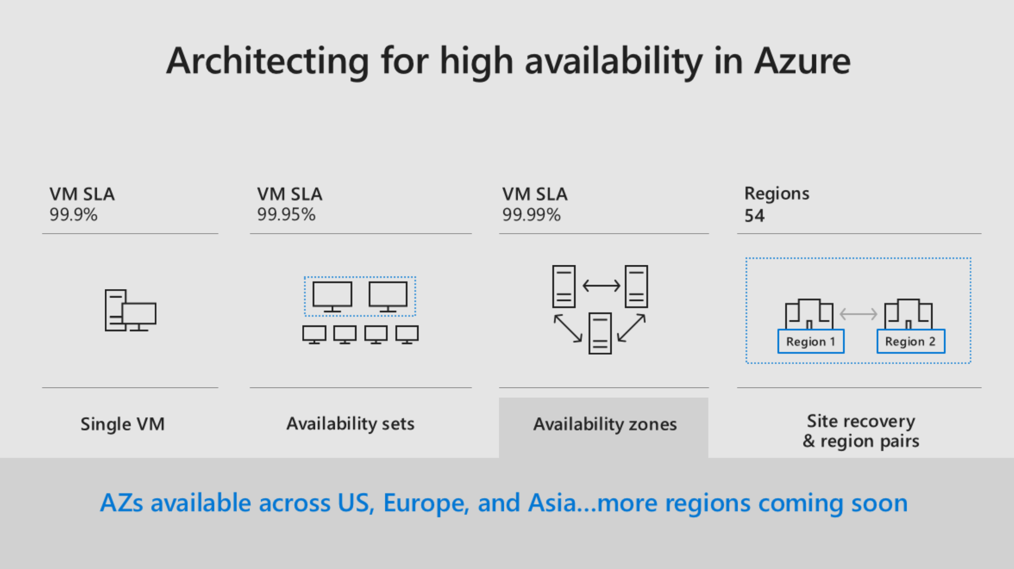

Slide 34
Cloud Native Applications
Leverages cloud platform services
Uses non-blocking async communication in a loosely coupled architecture
Scales horizontally, adding stateless resources as demand increases and releases resources as demand decreases
Uses durable storage for shared data
Handles transient failures without user experience degradation.
Handles node failures without downtime
Uses geographical distribution to minimize network latency
Monitors and manages application logs even as nodes come and go
See also the Twelve Factor App, 12factor.net

Slide 35
In Summary - Resiliency Capabilities for Success
Resiliency
Application architecture
Cloud design patterns
Azure services
Recognize different application patterns
Leverage cloud design patterns where appropriate
Familiarize yourself with appropriate Azure services

Slide 36
Core Enablement Capabilities for Success
Business
Opportunities for moving to the cloud
Security
Security Hygiene
Network strategy
Resiliency
Application architecture
Operations
Organizing resources
Automation
Automation capabilities
People strategy
Governance, Risk and Compliance
Cloud design patterns
Azure services
Cost management
Monitoring and management strategy
Automation opportunities
Identity and access control

Slide 37
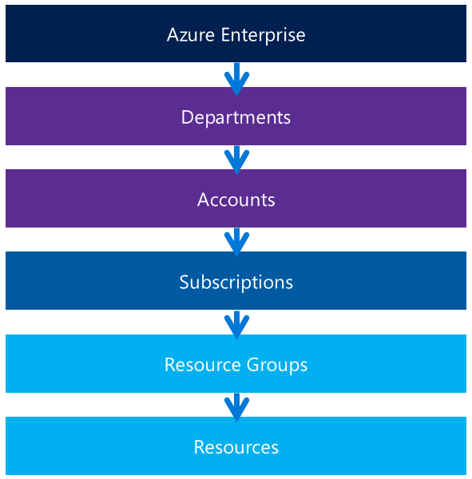
Account provisioning
Enterprise agreement,
The enterprise enrollment defines the shape and use of Azure services within a company and is the core governance structure
http://ea.azure.com
Define your hierarchy,
Customers can further subdivide the environment into departments, accounts, and finally, subscriptions.
Enterprise Portal | https://ea.azure.com
Account Portal | https://account.windowsazure.com
Classic Portal | https://manage.windowsazure.com
Azure Portal | https://portal.azure.com

Slide 38
Departments/Accounts – A Foundation
Functional
Business Division
Geographic
Enterprise
Enterprise
Enterprise
Enterprise
Departments
Finance
Marketing
Auto
Aerospace
North America
Europe
Accounts
Joe Smith
Jane Doe
Proj New Car
Proj New Plane
Ted Bear
Grace Ma
Subscriptions
Application 1
Application 2
Application 3
Project 1
Project 2
Project 3
Project 1 Dev
Project 1 Test
Production Web Sites
Adapted from the Azure Direct EA Onboarding Guide: https://eaportalonboardingvideos.blob.core.windows.net/onboardingvideos/AzureDirectEACustomerOnboardingGuide_En.pdf

Slide 39
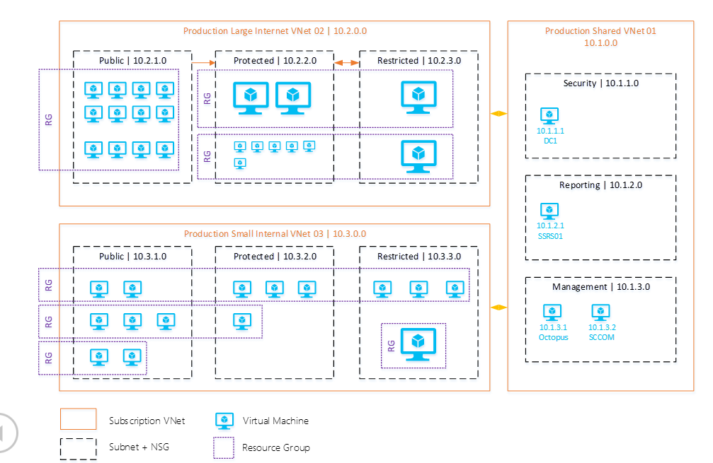
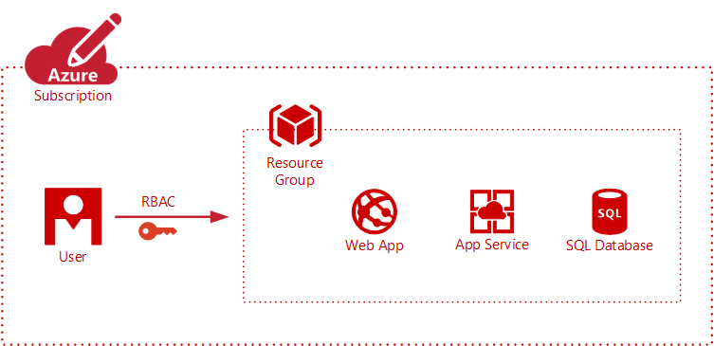
Resource Groups
Logically group related resources such as storage accounts, virtual networks, and virtual machines (VMs) to deploy, manage, and maintain them as a single entity.
This approach makes it easier to deploy applications while keeping all the related resources together from a management perspective, or to grant others access to that group of resources.

Slide 40
Naming Convention
You should have a good naming convention in place before creating anything in Azure. A naming convention ensures that all the resources have a predictable name, which helps lower the administrative burden associated with managing those resources
Aspect | Examples | Notes
Environment | dev, stg, prod | Depending on the purpose and name of each environment.
Location | usw (West US), use (East US 2) | Depending on the region of the datacenter or the region of the organization.
Azure component, service, or product | Rg for resource group, VNet for virtual network | Depending on the product for which the resource provides support.
Role | db, app, web | Depending on the role of the virtual machine.
Instance | 01, 02, 03, etc. | For resources that have more than one instance. For example, load balanced web servers in a cloud service.

Slide 41
Naming Convention Real World Example
Subscription: contoso-marketing-apps-prod
Resource Group: rg-ctw-marketing-apps-prod-ue1-appx
Virtual Network: vnet-ctw-marketing-apps-prod-ue1
Subnet: snet-ctw-marketing-apps-prod-ue1-entfacing or snet-ctw-marketing-apps-prod-ue1-appx
Network Security Group: nsg-appx-web-vm1 or nsg-snet-ctw-marketing-apps-prod-ue1
Storage Account: sa ctw pr ue1 appx <last 5 sub guid>
Windows VM: appx-web-vm1
Load Balancer: lb-prod-ue1-appx-web

Slide 42
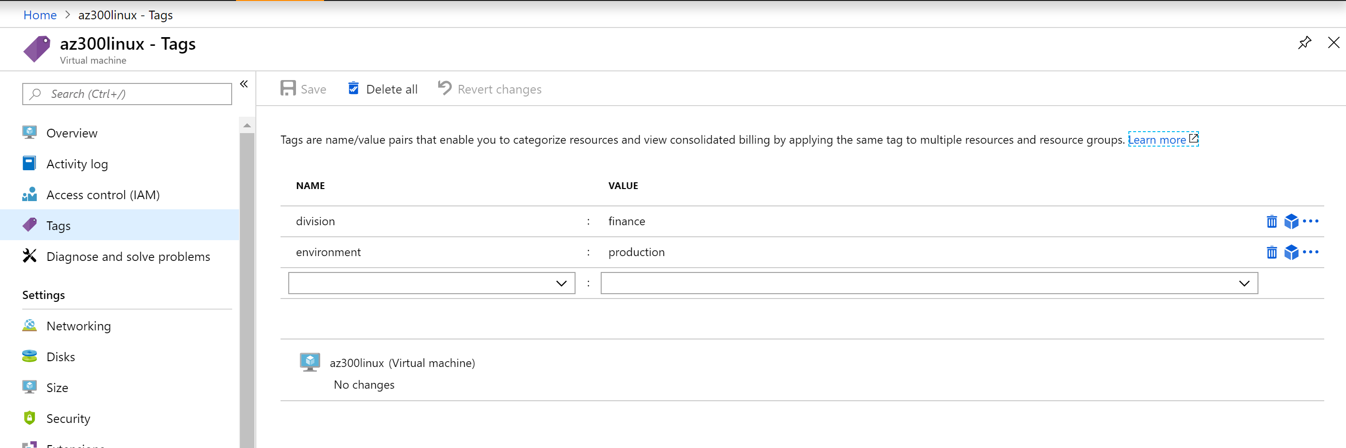
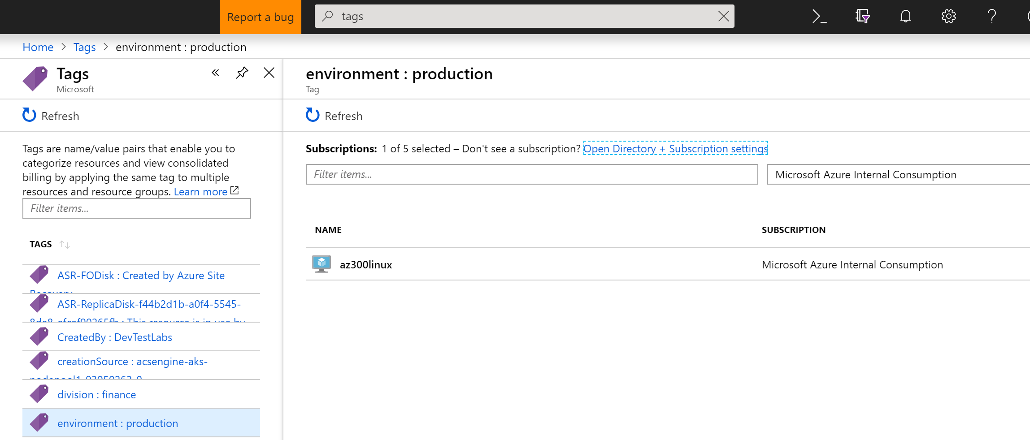

Slide 43
Azure policy for enterprise cloud control and compliance
Turn on built-in policies or build custom ones for all resource types
Apply policies to a Management Group with control across your entire organization
Real time remediation
Real-time policy evaluation and enforcement
Apply multiple policies and & aggregate policy states with policy initiative
Remediation on existing resources (Ignite 2018)
Periodic & on-demand compliance evaluation
Exclusion Scope
Enforcement & Compliance
Apply policies at scale
Remediation

Slide 44
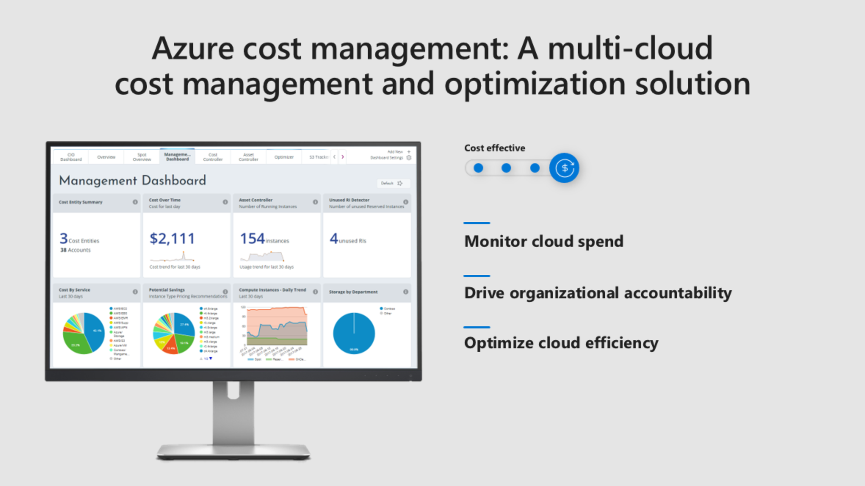

Slide 45
Optimize your cost spend
Choose the Azure services that align to your:
Application Needs
+
Cost Objectivies
Consider Autoscaling, AutoShutdown & Policies
Compute
VM Type | When To Use It
Pay-As-You-Go VMs | Ad-hoc projects, dev/test
Reserved VMs | Workloads known to run long-term
Low Priority VMs | Batch processing; tolerant to interruption
Burstable VMs | Workloads with fluctuating CPU needs
Storage
Blob Type | When to Use It
Hot | Frequently accessed data
Cool | Occasional data access
Archive | Very rare data access

Slide 46
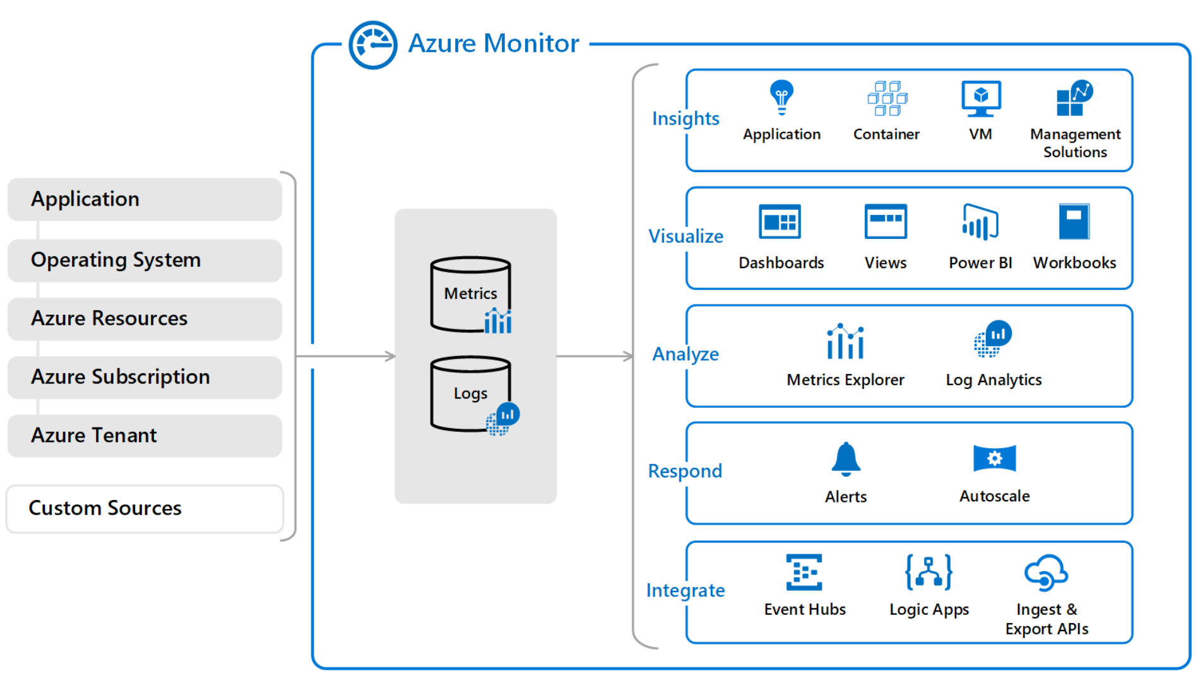
Azure Monitor Platform

Slide 47
In Summary - Operational Capabilities for Success
Operations
Organizing resources
Cost management
Monitoring and management strategy
Think through how you want to organize your resources, e.g., show back implications, naming
Adopt Cost Management
take advantage of opportunities to enforce policy and auto scale where appropriate, e.g., the “programmable thermostat”
Understand what health looks like and have a plan.
Leverage Azure Monitor, Log Analytics and Application Insights
Leverage Azure Advisor, Azure Service Health and Azure Security Center

Slide 48
Core Enablement Capabilities for Success
Business
Opportunities for moving to the cloud
Security
Security Hygiene
Network strategy
Resiliency
Application architecture
Operations
Organizing resources
Automation
Automation capabilities
People strategy
Governance, Risk and Compliance
Cloud design patterns
Azure services
Cost management
Monitoring and management strategy
Automation opportunities
Identity and access control

Slide 49
Automation
Common ways to interact with Azure
Portal
REST API
Command Line –
CLI (More popular with Linux/Mac/Unix background)
Powershell (More popular with Windows background)
ARM Templates
Azure Automation
Alerting

Slide 50

Configuration & Automation Scenarios
Build
Create VMs and Cloud infrastructure
Integrate into Dev tools
Configure
Update management
Configure cloud and VMs per application
Monitor
Identify changes causing issues
Integrate into ITSM solutions on Alerts
Protect
Recover application / VM from backup
Secure
Quarantine VM if exploited
Govern
Set up RBAC per user / group
Integrate into Site Recovery for fail over
Set policy for infrastructure and app
Recover unused resources
GOVERN
BUILD
Configuration & Automation
SECURE
CONFIG
PROTECT
MONITOR

Slide 51
In Summary - Automation Capabilities for Success
Automation
Automation capabilities
Automation opportunities
Leverage Automation as much as possible
Azure Automation and RunBooks
ARM templates
Scripting/CLI/Powershell, etc
Alerting
Policies
Azure Site Recovery for failover
etc
Strive for “Infrastructure as Code”, particularly as it relates to automated builds, development pipelines, CI/CD, etc.

Slide 52
How to get started
Assess
Prioritize
Improve
In house
Partner
Dashboard
Top couple
Business
Opportunities for moving to the cloud
Security
Security Hygiene
Network strategy
Resiliency
Application architecture
Operations
Organizing resources
Automation
Automation capabilities
People strategy
Governance, Risk and Compliance
Cloud design patterns
Azure services
Cost management
Monitoring and management strategy
Automation opportunities
Identity and access control

Slide 53
Additional Resources
Adopting the Microsoft Cloud Operating Model
Azure strategy and implementation guide, second edition
Azure Architecture Center
CIS Benchmarks
CIS Microsoft Azure Foundations

